Slide 1
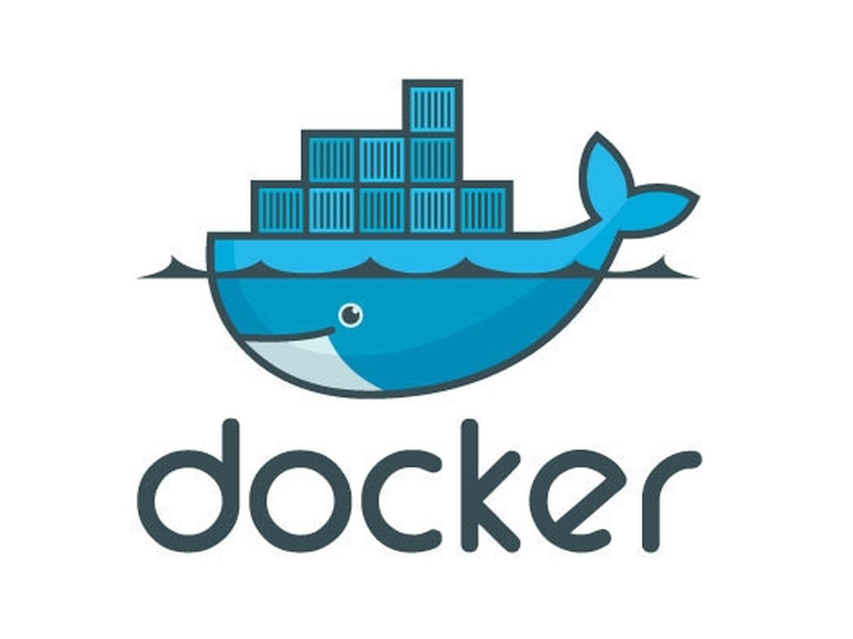
Labs on Docker
Vaibhav/Pardeep
Cloud COE Team

Slide 2

Name: Vaibhav Gupta
Designation: Consultant Architect
Team: Cloud COE
Experience (Yrs): 12.5
Expertise: Docker | K8s | Cloud | Devops | Microservices | Server less | Migration | Presales | Consulting
LinkedIn: www.linkedin.com/in/vg-cloud-world
Github: https://github.com/VaibhavG10
Dockerhub: https://cloud.docker.com/u/vaibhav2016

Slide 3
Agenda
Introduction
Onboarding & Account creation
Lab 1 : Deploying Your First Docker Container
Lab 2: Building Container Images
Lab 3: Persisting Data Using Volumes
Lab 4: See Container Metrics With Docker Stats
Lab6(O): Useful Commands
Q n A
Summary and Next Steps

Slide 4
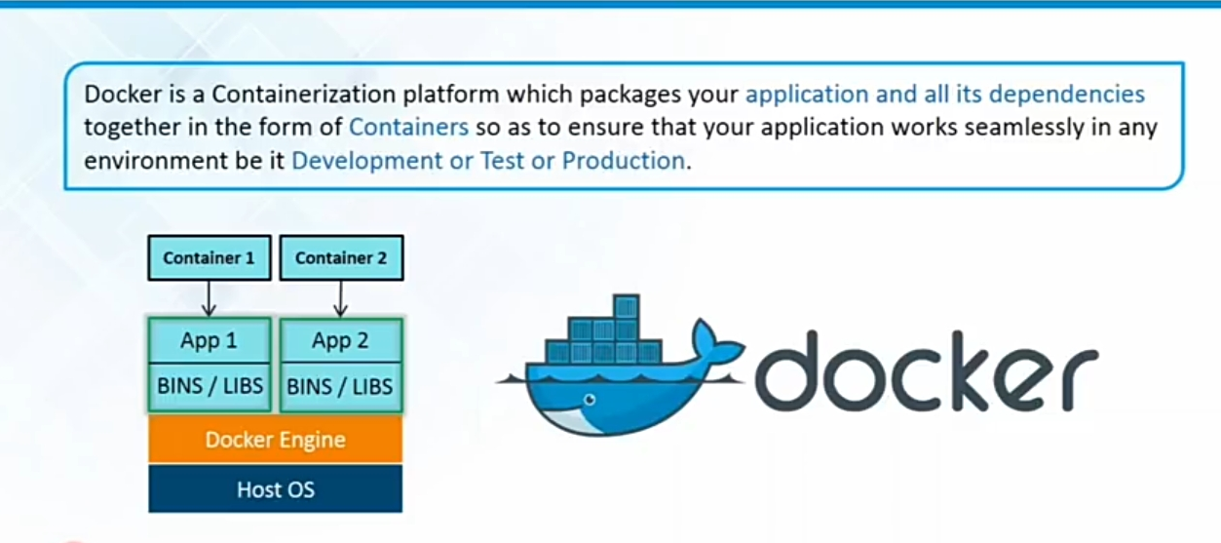
Docker

Slide 5
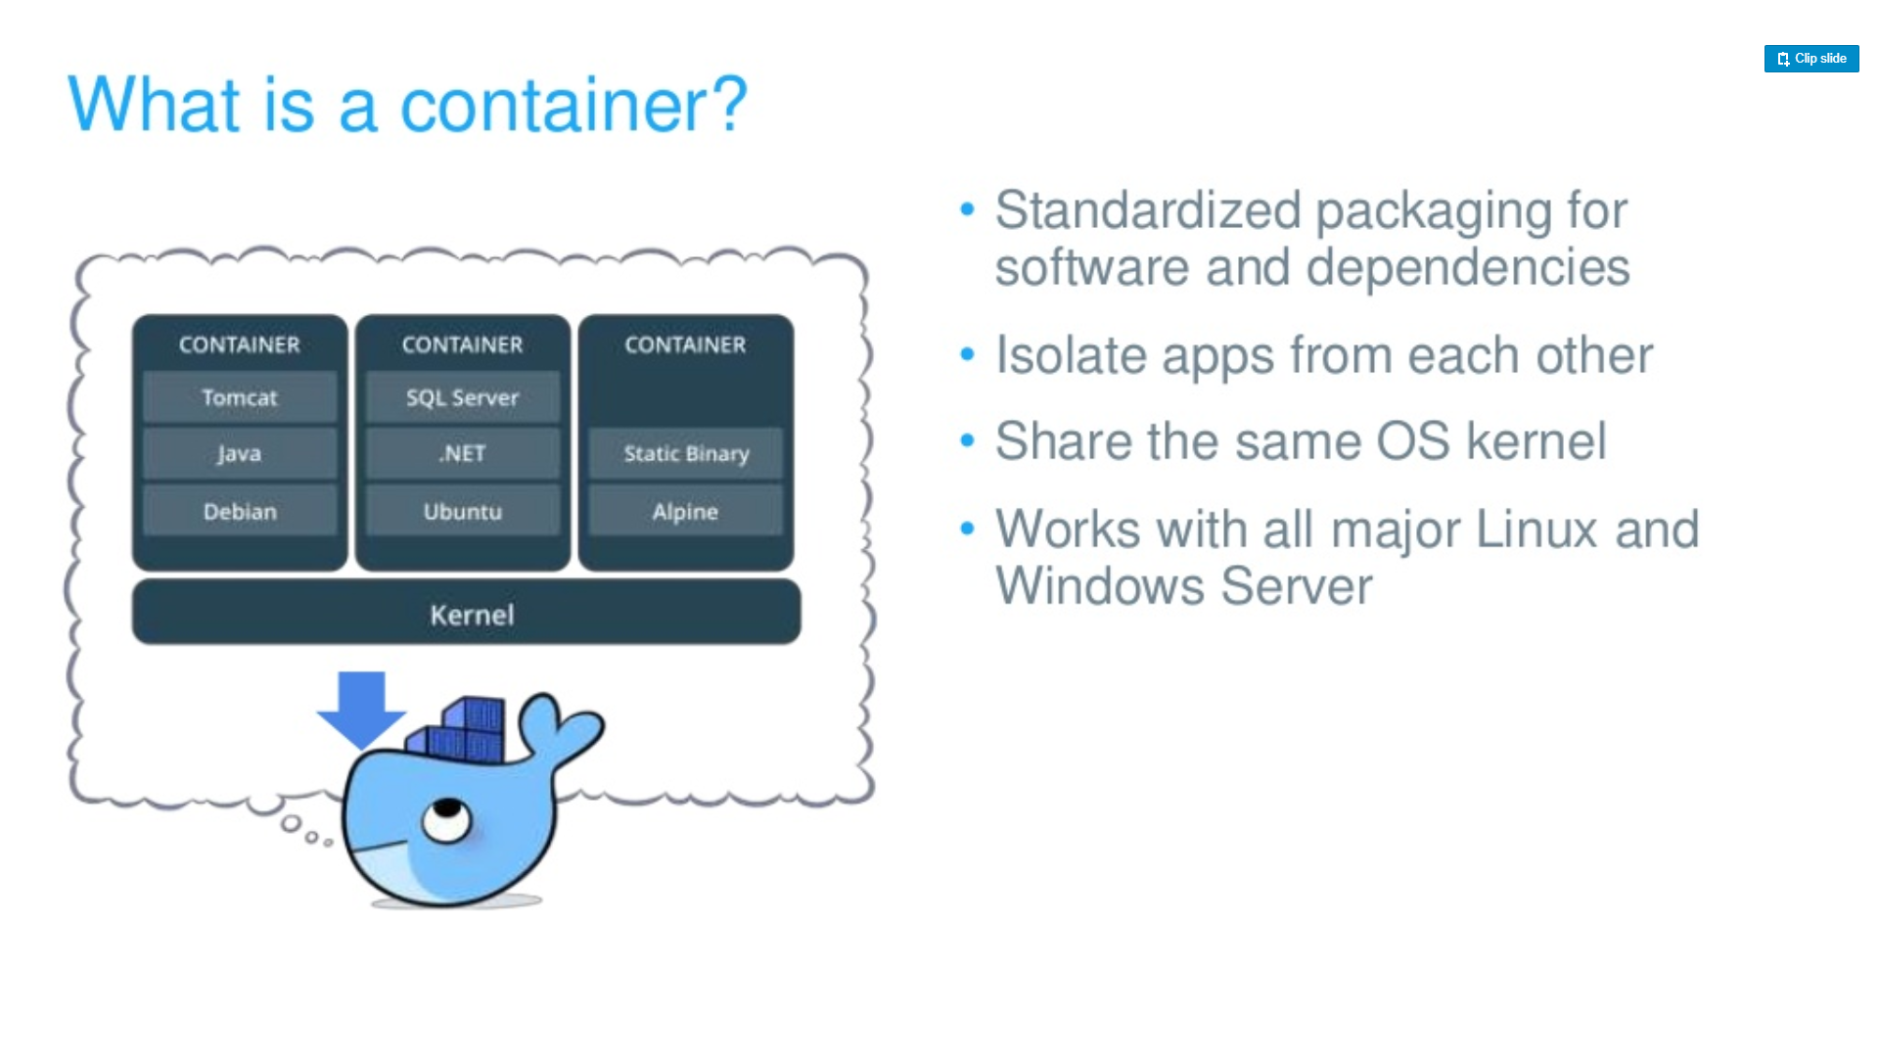
Container

Slide 6
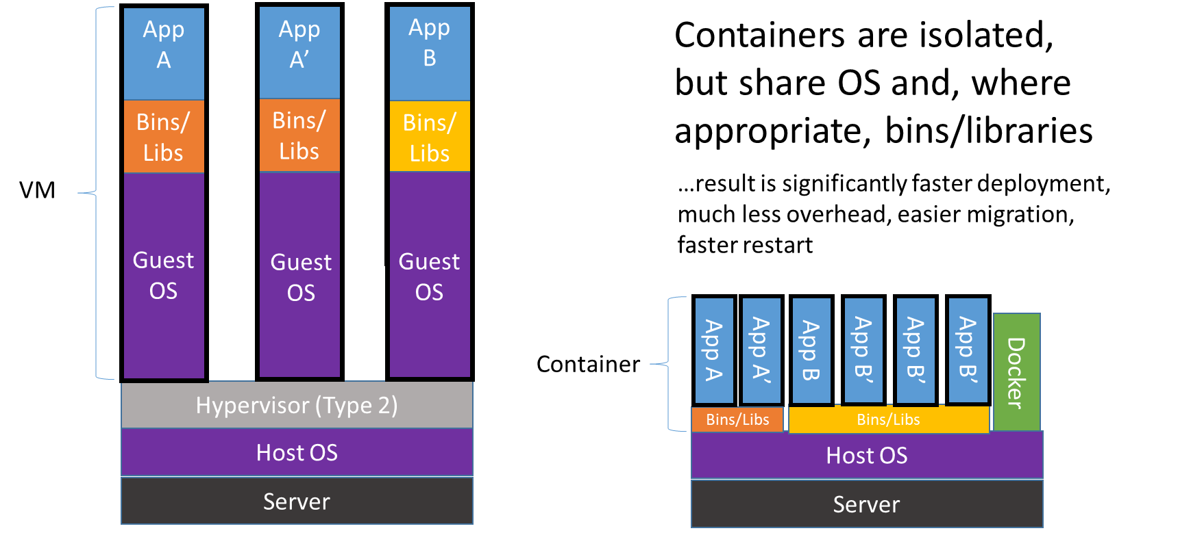
Containers vs. VMs

Slide 7
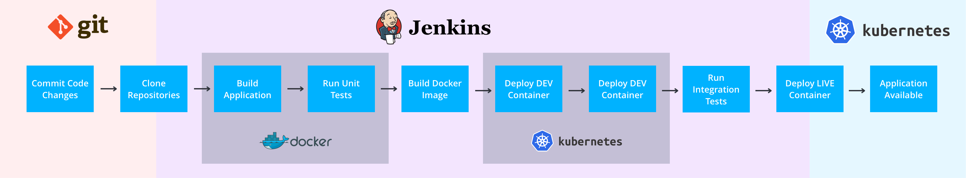
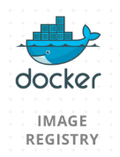
Build & deployment concept

Slide 8
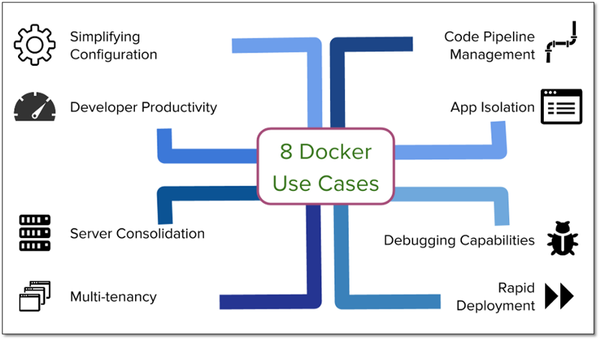
Use Cases
Notes:
https://medium.com/@nagarwal/docker-usecases-3b62f4d68bc4

Slide 9
Use Cases
Docker lets you put your environment and configuration into code and deploy it. The same Docker configuration can also be used in a variety of environments. This decouples infrastructure requirements from the application environment.
Use same code with different-2 container environment
Notes:
https://medium.com/@nagarwal/docker-usecases-3b62f4d68bc4

Slide 10
Use Cases
Docker helps to provide developer environment as close as possible to production by deploying container based services on its own environment.
Docker also provide fast & flexible development environment
Notes:
https://medium.com/@nagarwal/docker-usecases-3b62f4d68bc4

Slide 11
Use Cases
The application isolation abilities of Docker allows consolidating multiple servers to save on cost. Docker provides far denser server consolidation than you can get with VMs.
Notes:
https://medium.com/@nagarwal/docker-usecases-3b62f4d68bc4

Slide 12

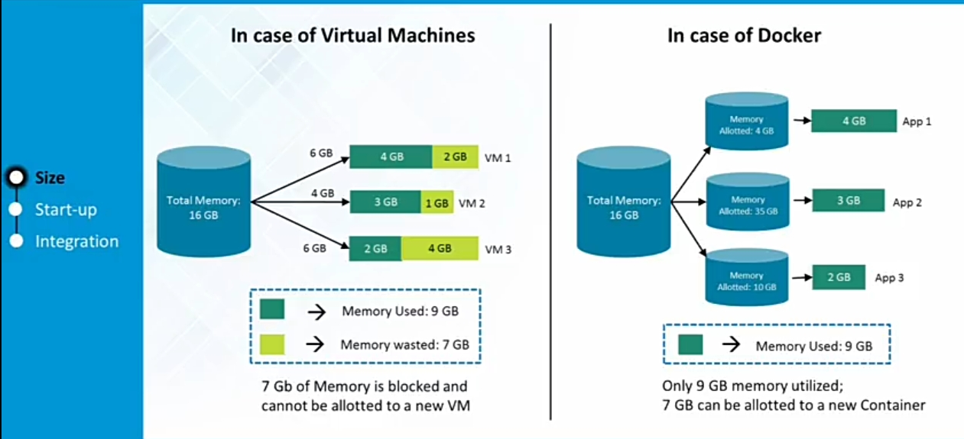

Slide 13
Use Cases
Using Docker, it was easy and inexpensive to create isolated environments for running multiple instances of app tiers for each tenant.
E.g. for every customer(tenant) you can customize gmail look & feel
Note: Multi-tenancy is an architecture in which a single instance of a software application serves multiple customers
Notes:
https://medium.com/@nagarwal/docker-usecases-3b62f4d68bc4

Slide 14
Use Cases
Docker provides a consistent environment for the application from dev through production, easing the code development and deployment pipeline
Achieve zero change in application runtime environments across dev through production.
Notes:
https://medium.com/@nagarwal/docker-usecases-3b62f4d68bc4

Slide 15
Use Cases
Using Docker we can run two REST API servers, both of which use flask. But, each of them uses a slightly different version of flask and other such dependencies.
Easily avoid dependency hell scenario
Notes:
https://medium.com/@nagarwal/docker-usecases-3b62f4d68bc4

Slide 16
Use Cases
Create a separate production like environment in minute and troubleshoot issue.
Notes:
https://medium.com/@nagarwal/docker-usecases-3b62f4d68bc4

Slide 17
Use Cases
No Need to order new hardware for development
By creating just a container for the process and not booting up an OS
Notes:
https://medium.com/@nagarwal/docker-usecases-3b62f4d68bc4

Slide 18
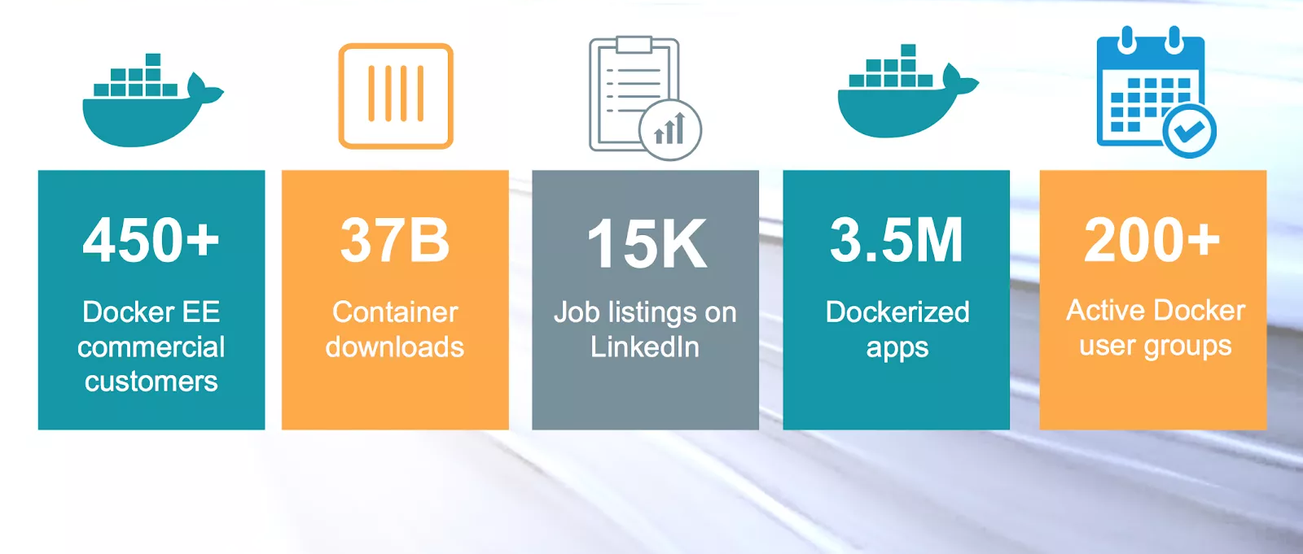
Docker Momentum (Mar 2018)

Slide 19

Labs
Let’s Start

Slide 20
Onboarding & Account Creation
Goto https://www.katacoda.com/courses/docker/playground portal
Create your account here.
Please wait do not run redis ☺

Slide 21
Common :
Task 1: Download Files
Task 2(O): How to Create & Save file
Download files from github:
git clone https://github.com/VaibhavG10/docker-labs-basic
cd docker-labs-basic/
Open Playground
vi file.txt
Press “i” for edit mode
Paste copied data
Press “esc”
Write “:wq” to save & exit

Slide 22
Lab1: Deploying Your First Docker Container
Learn how to launch containers using Docker
Hello World
Interactive mode
Container in the background
Start container with name
Port mapping

Slide 23
Lab1:
Task 1: Hello World
Task 2: Interactive docker container
docker pull busybox
docker run busybox echo hello world
docker ps
docker ps –a
docker run -it ubuntu bash
hostname
exit
docker ps
docker ps –a

Slide 24
Lab1:
Task 3: Container in the background
Task 4: Start container with name
docker run -d ubuntu bash -c "while true; do ping 8.8.8.8; done"
docker ps
docker run -d --name myubuntu ubuntu bash -c "while true; do ping 8.8.8.8; done"
docker ps | grep myubuntu
docker kill myubuntu

Slide 25
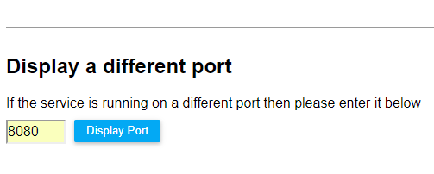
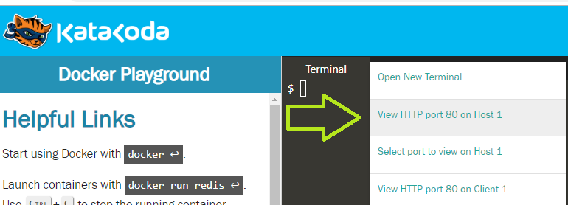
Lab1:
Task 5: Port mapping
docker run -d -p 8080:80 --name webserver-1 nginx
docker run -d -p 8081:80 --name webserver-2 nginx
curl docker:8080
curl docker:8081

Slide 26
Lab2: Docker Image
Learn how to build and launch your own container images
Learn how to create a docker image from running container
Create custom docker image
Tag & Version
Run a container from created docker image

Slide 27
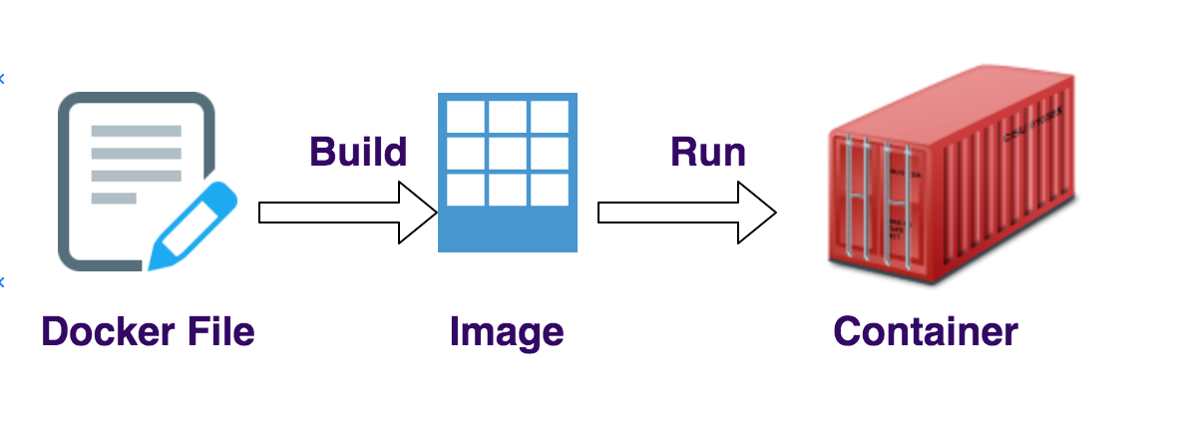
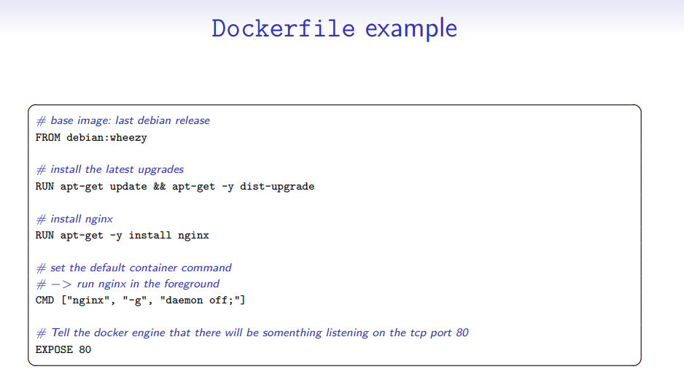
Docker File

Slide 28
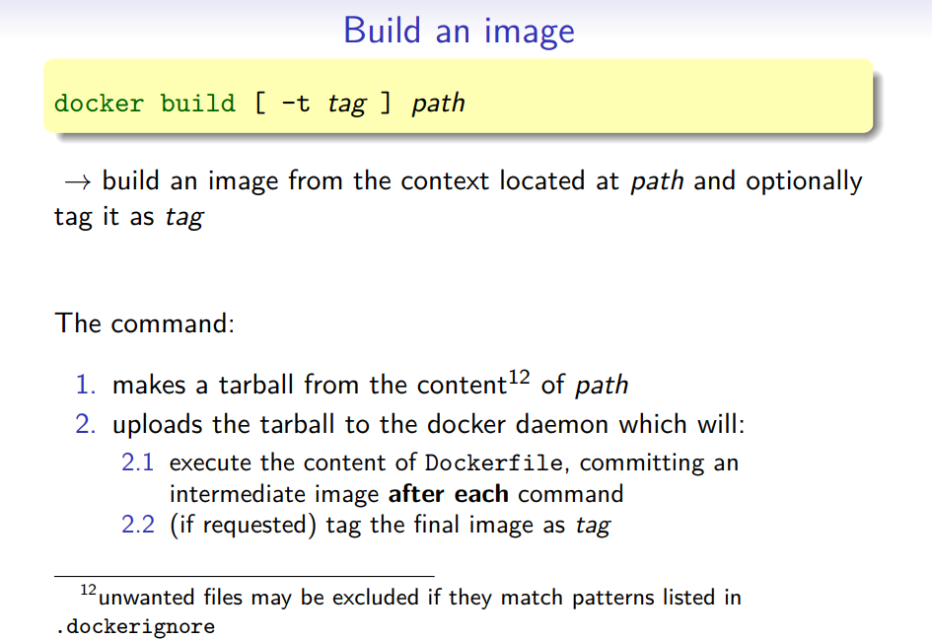

Slide 29
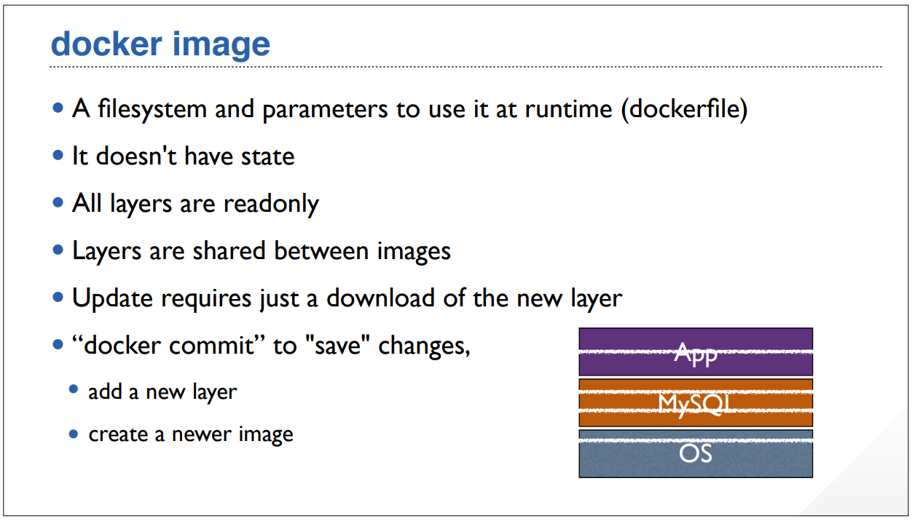

Slide 30
Lab2:
Task 1: Build Image from Dockerfile
Task 2: Run a container from image
cd docker-labs-basic/
docker build -t nginx-image:v01 .
docker images
docker run -d -p 80:80 nginx-image:v01

Slide 31
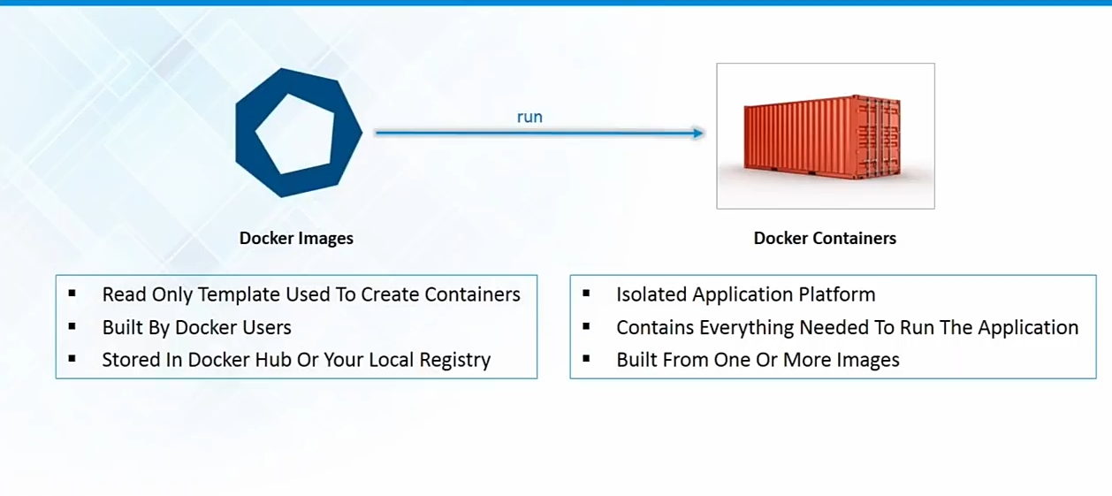
Docker Image

Slide 32
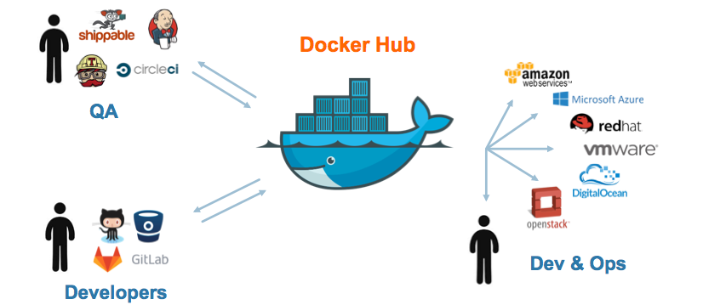
Docker Hub & Container Registry

Slide 33
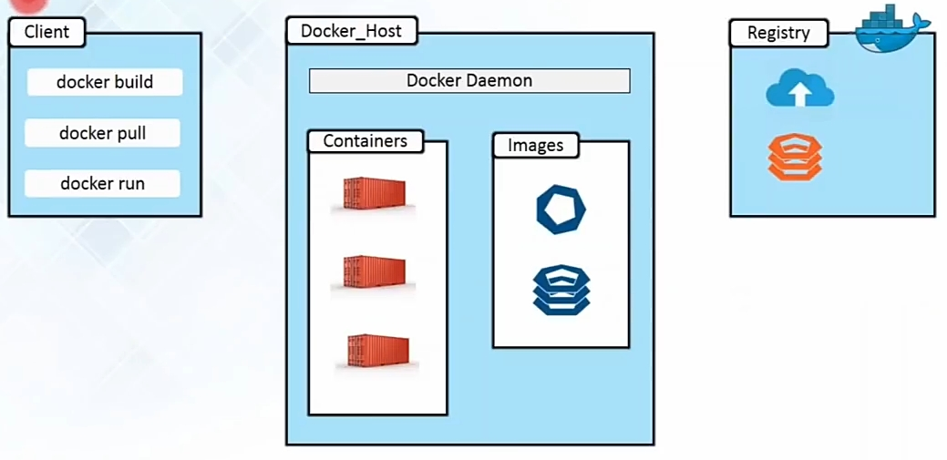
Docker Architecture

Slide 34
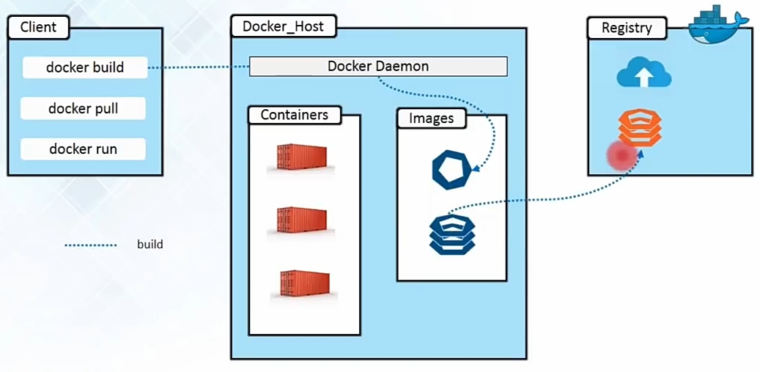
Docker Architecture

Slide 35
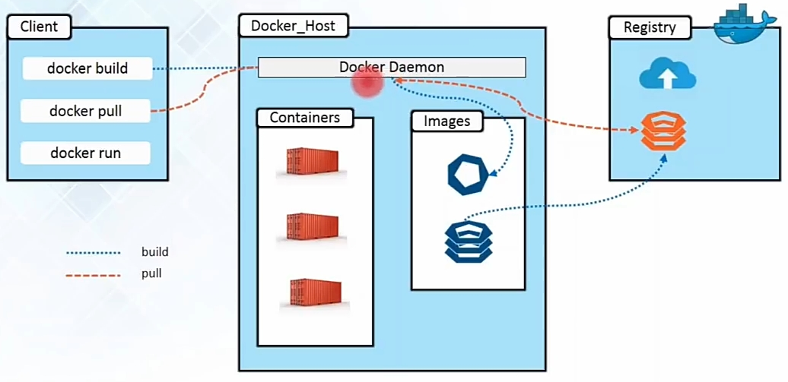
Docker Architecture

Slide 36
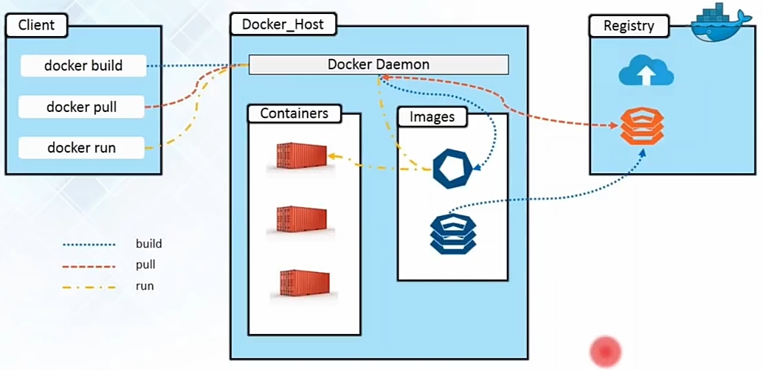
Docker Architecture

Slide 37
Lab2:
Task 3: Create Image from Container
docker run -d --name nginx-container -p 8082:80 nginx
docker commit nginx-container nginx-new
docker images | grep nginx-new

Slide 38
Lab3: Persisting Data Using Volumes
Learn how to persist and share data between containers using Volumes
Attach Volume to container
Attach Volume to another container using "--volumes-from"

Slide 39
Lab3:
Task 1: Attach host volume
Task 2: volume from other container
mkdir /data
docker run -d -v /data:/usr/share/nginx/html -p 8083:80 --name WebContainer nginx
curl docker:8083/test.html
echo “helloworld" >> test.html
docker cp test.html WebContainer:/usr/share/nginx/html/
curl docker:8083/test.html
docker run -d -p 8084:80 --name newweb --volumes-from WebContainer nginx
curl docker:8084/test.html

Slide 40
Lab4: See Container Lifecycle
Check different Docker commands to manage container lifecycle
Check out different docker commands
Difference b/w stop & kill

Slide 41
Lab 4:
Task 1: Docker Lifecycle
docker run -d --name nginx-container -p 8085:80 nginx
docker stop nginx-container
docker start nginx-container
docker kill nginx-container
docker rm -f nginx-container
docker ps

Slide 42
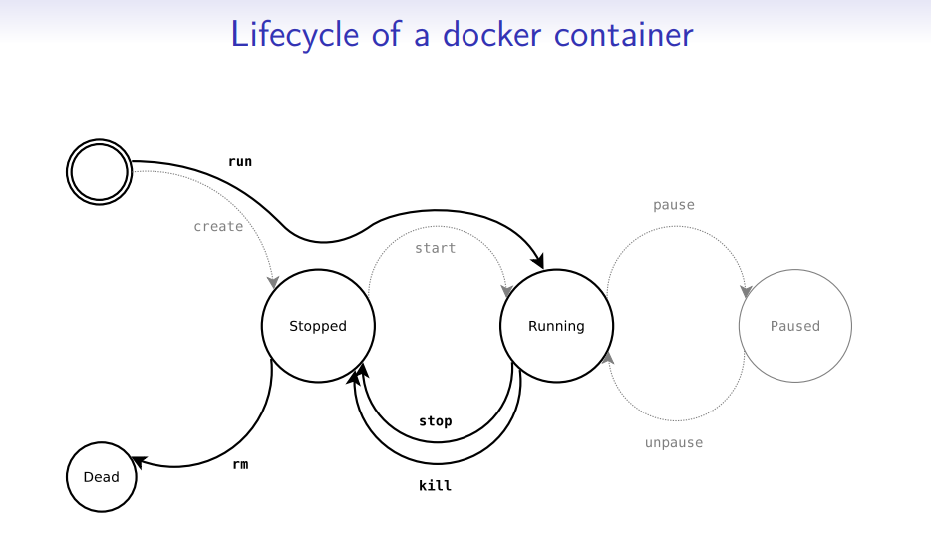

Slide 43
Lab5(O): Useful Commands
Find out other useful docker commands
Check docker logs
Check docker inspect
Check cleaning commands

Slide 44
Lab5:
Task 1: General Commands
Task 2: Cleanup Commands
docker run -d --name WebContainer nginx
docker exec –it WebContainer bash
docker logs WebContainer
docker inspect WebContainer
docker volume/network ls
docker start/stop WebContainer
docker images
docker rm -f $(docker ps -q)
docker container prune
docker volume rm $(docker volume ls -q)
docker rmi -f $(docker images -q)

Slide 45

Q&A

Slide 46
Summary & Next Steps
Summary:
Docker
Container
Containers vs. VMs
Benefits
Docker Image
Docker Hub & Container Registry
Docker File
Docker Architecture
Labs
Useful Url’s:
https://docs.docker.com/compose/overview/
https://www.docker.com/sites/default/files/Docker_CheatSheet_08.09.2016_0.pdf
https://forums.docker.com/
https://labs.play-with-docker.com
What’s Next:
Install docker CE on your workstation
Practice with real time scenario’s
Create custom image and play with containers
Explorer different use cases of containers

Slide 47

Thanks

Slide 48
Docker Image vs. Container
Base Image
ubuntu:latest
run
Container
cid1
base image
cmd → new state
New Image
iid1
commit
Container
cid1
run
Container
cid2
Container
cid3
Container
cid4

Slide 49
VIRTUAL MACHINES AND CONTAINERS
Virtual Machine
Application OS dependencies Operating System
Container
Application
OS dependencies
Container Host
VM Isolation Complete OS Static Compute Static Memory
High Resource Usage
Container Isolation Shared Kernel Burstable Compute Burstable Memory Low Resource Usage

Slide 50
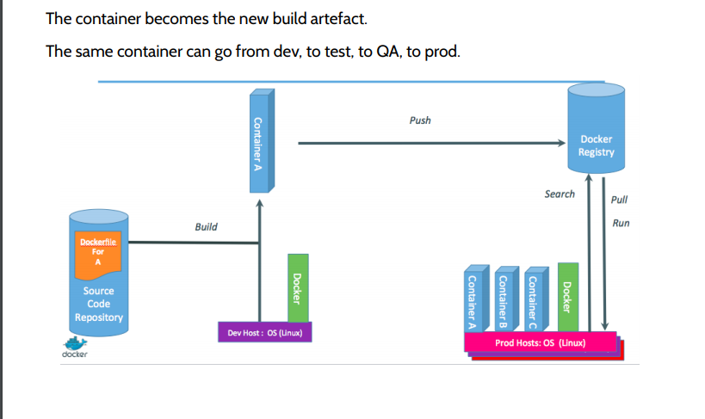

Slide 51
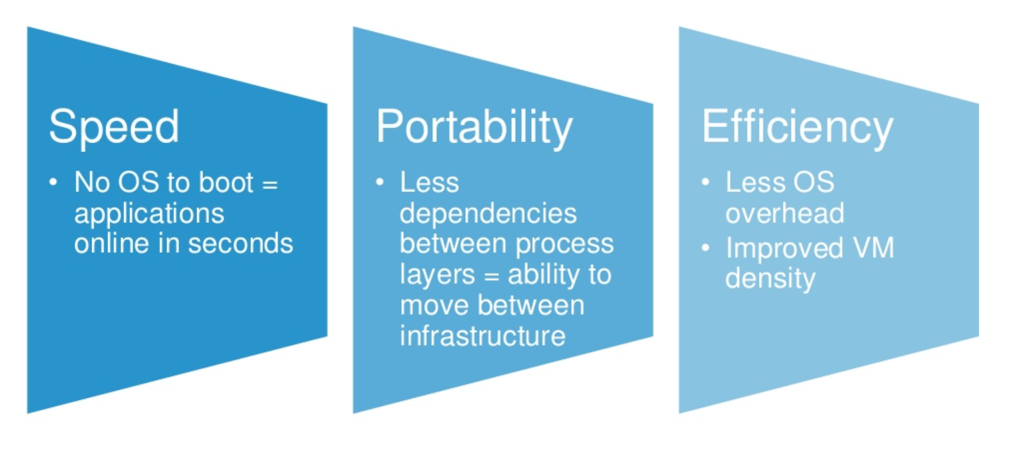
Benefits

